Slide 1
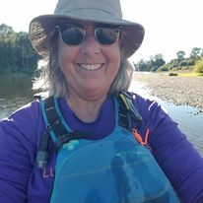
Kayak Camping
Tips, Tricks and Places to Go
Gena Dwyer
(not an expert)

Slide 2
Kayak Camping: Tips and Tricks
Gear
Campsite and Gear
Kitchen and Cooking
Health and Safety
Trip Planning

Slide 3
Gear
Paddling
Normal Kayak Kit
+spare paddle
Camping
Think small (backpacking)
Many small dry bags (windows or labeled)
Compression sacks
Water
How to pack
Pointy ends of kayak
Trim
Accessibility

Slide 4
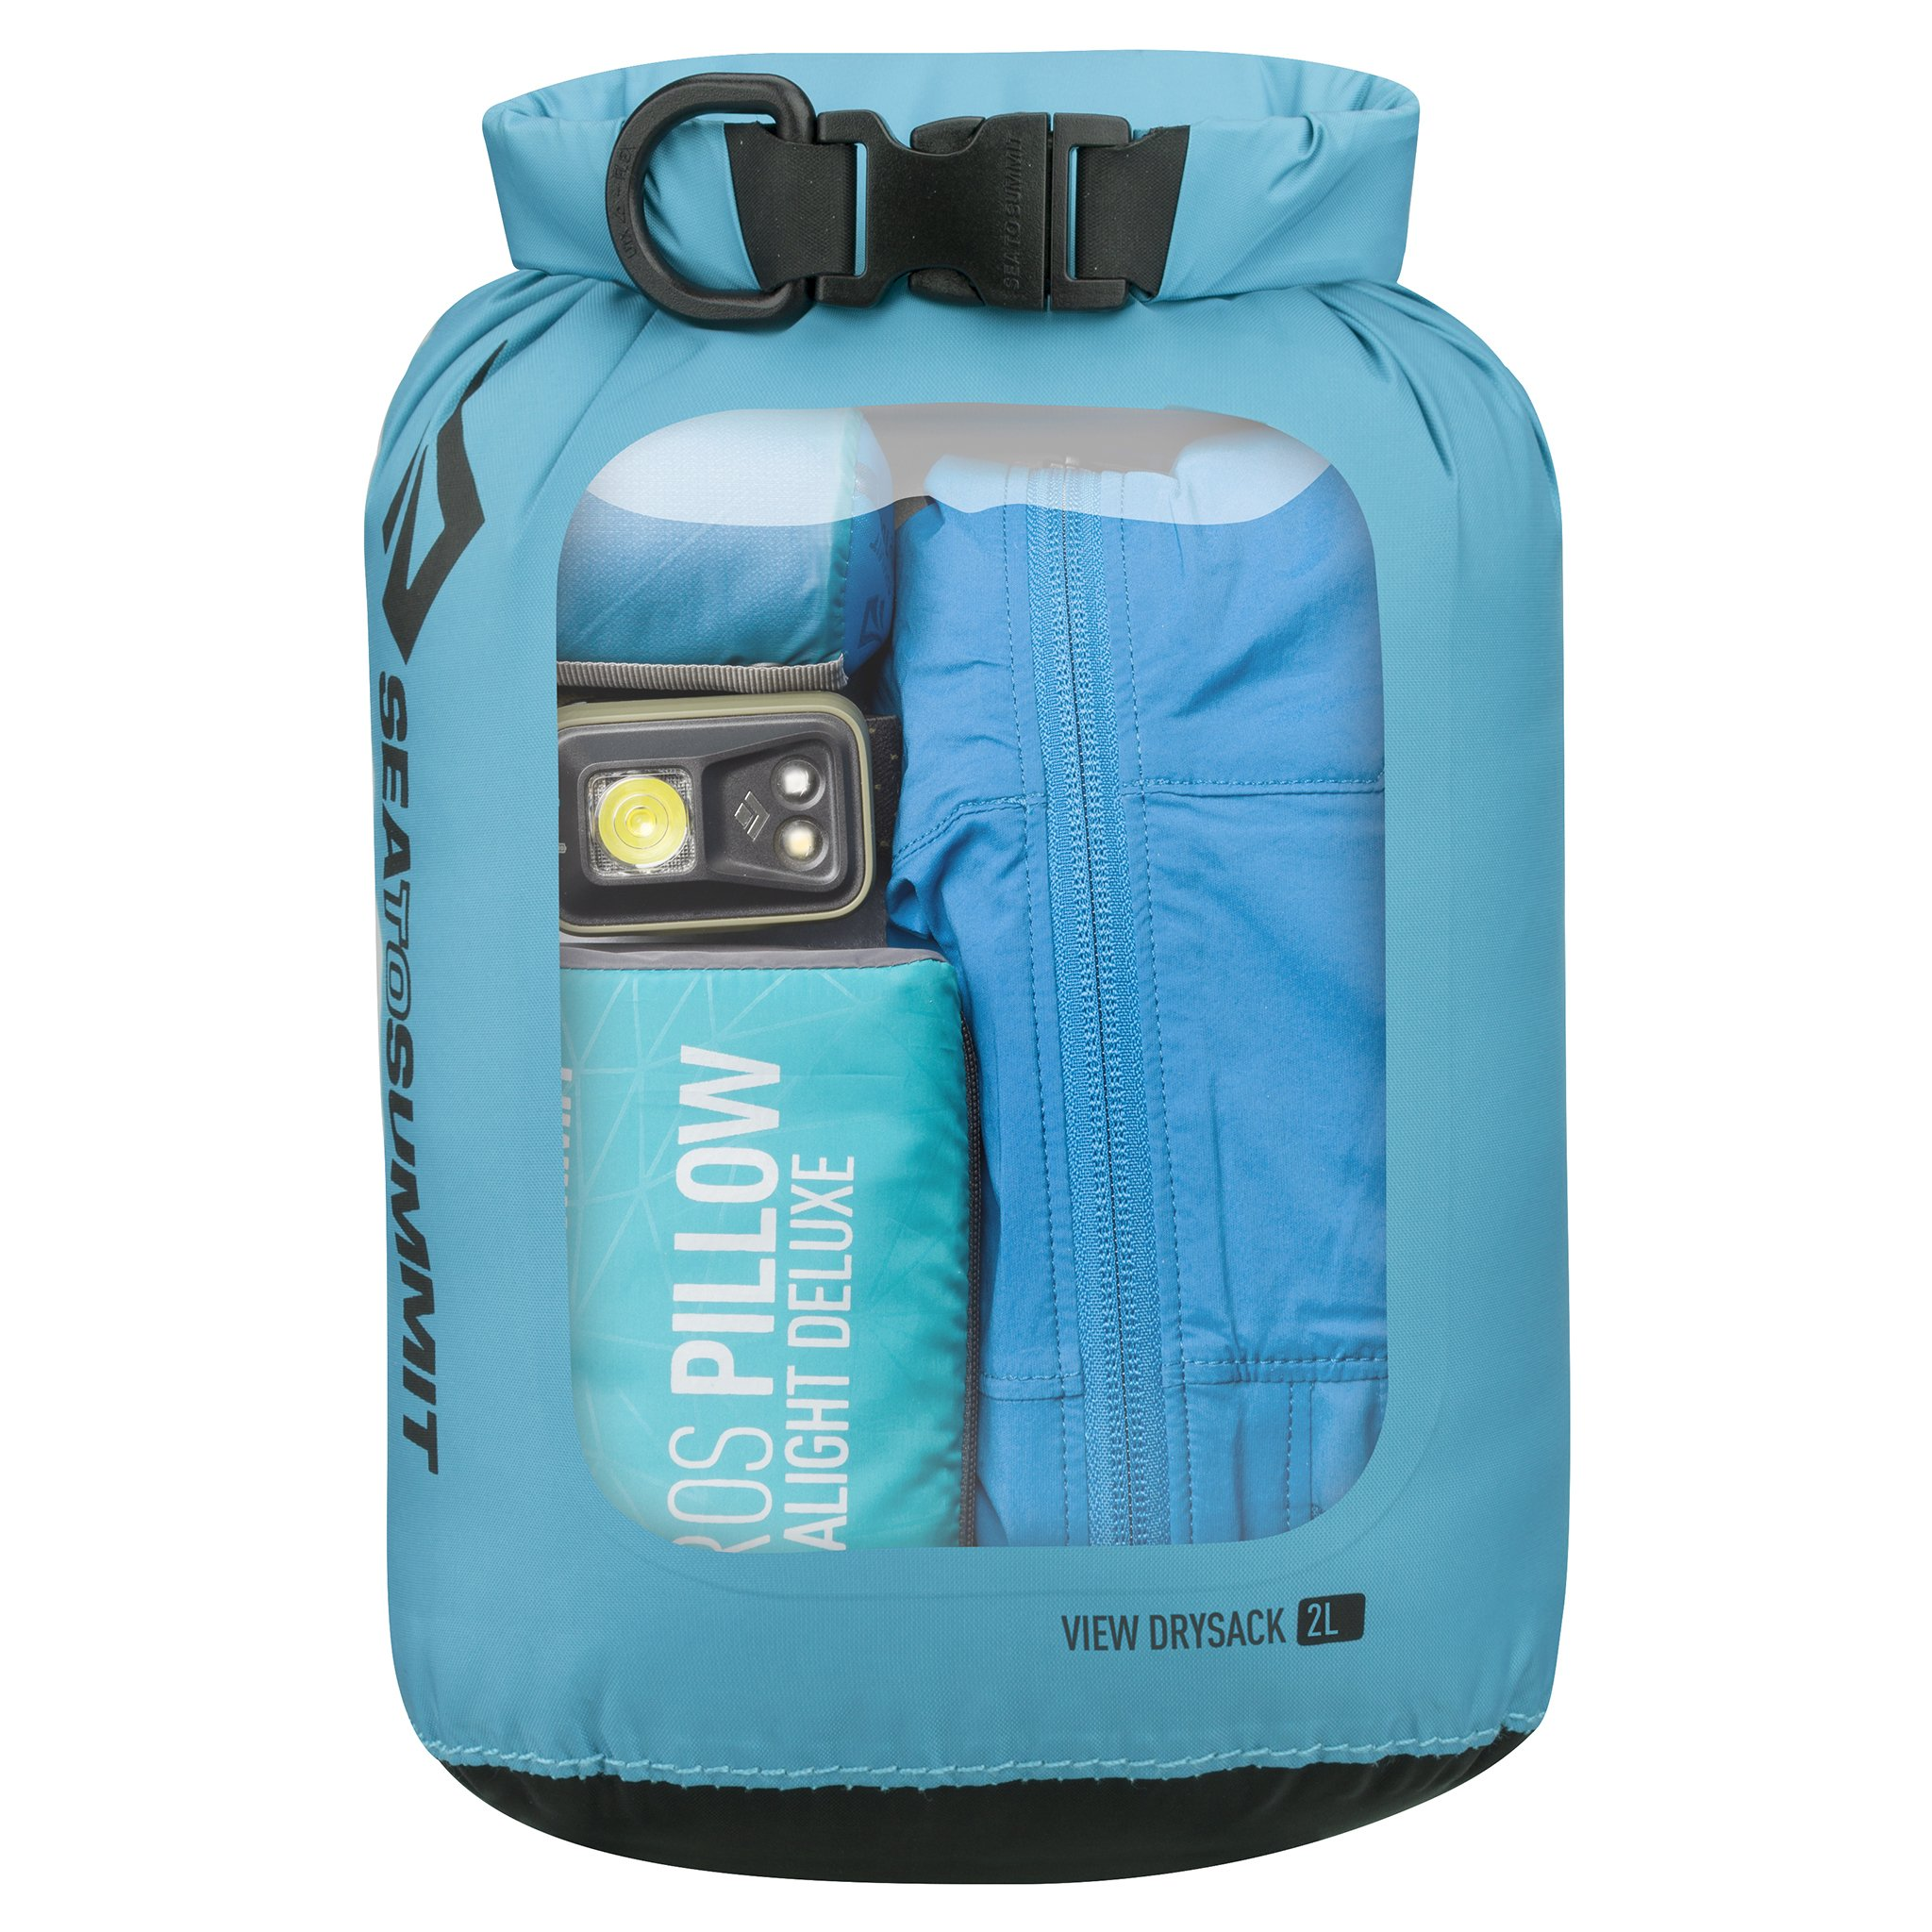

Slide 5
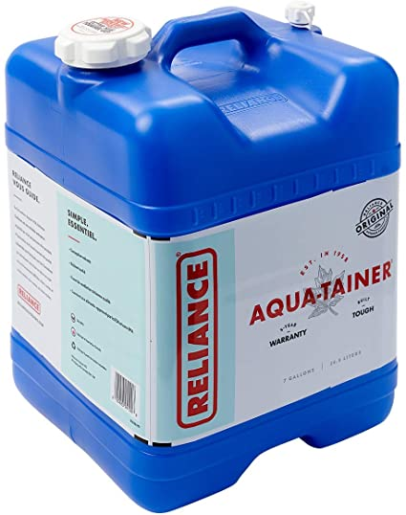
Water
Good example
This won’t work well.

Slide 6
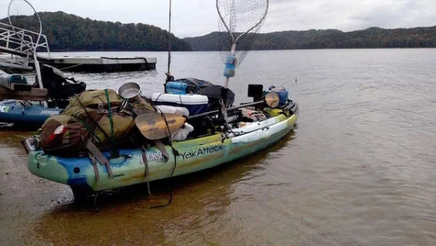

Slide 7
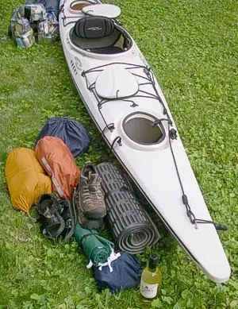
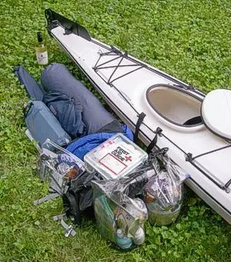

Slide 8
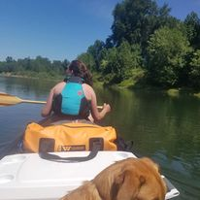
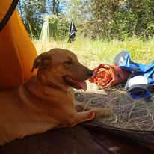
The day hatch…
Keep things in the day hatch that you want to put your hands on quickly.
Water
First aid kit
Lunch/Snacks
Poop kit
Doggie bags...

Slide 9
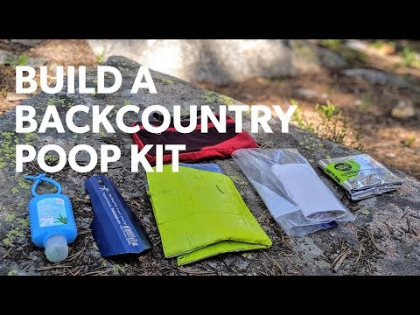

Slide 10
What is your “must have” camping gear?
Put your favorite piece of camping gear in the chat!

Slide 11
Camping Kitchen
What to eat?

Slide 12
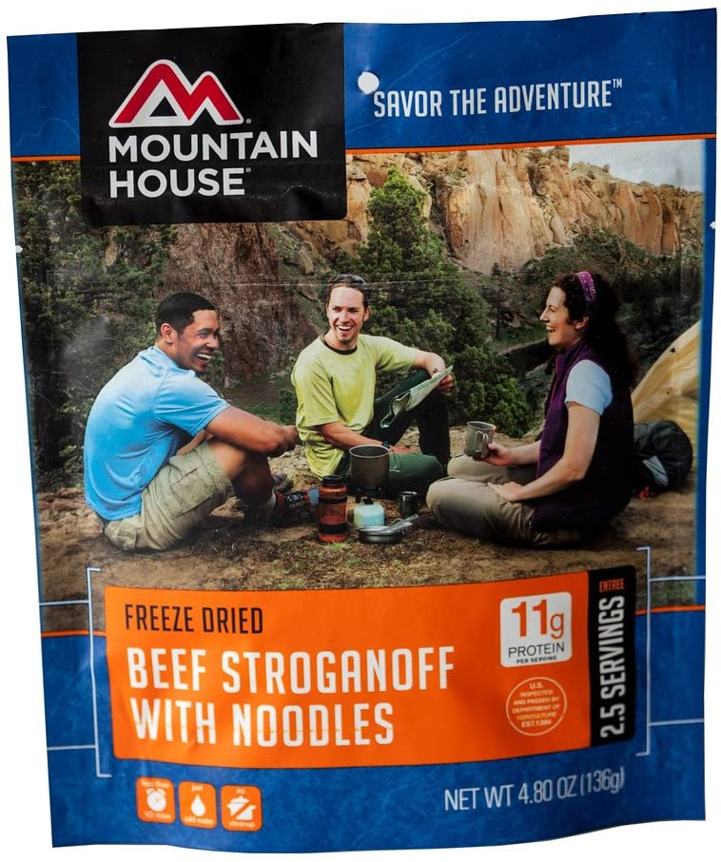
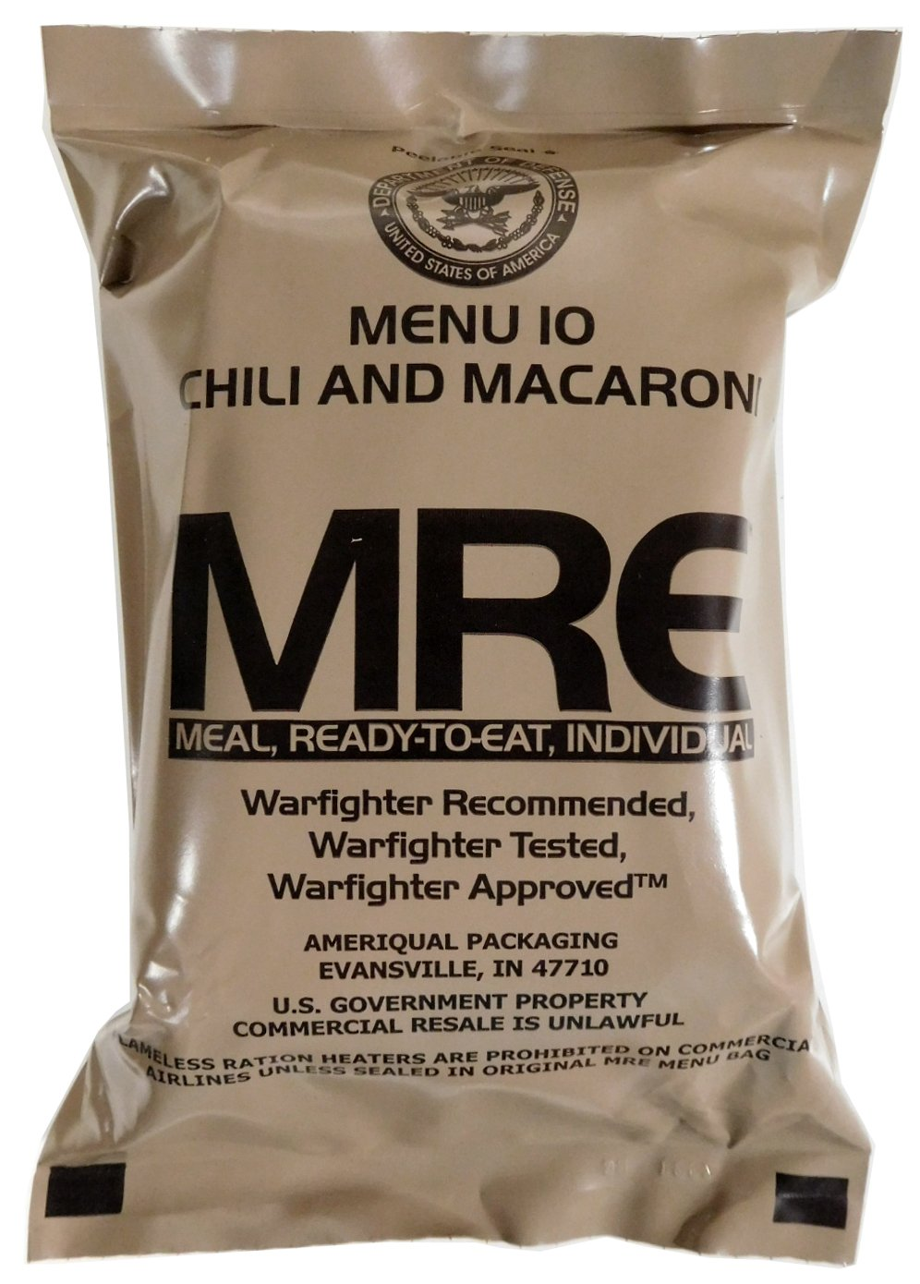
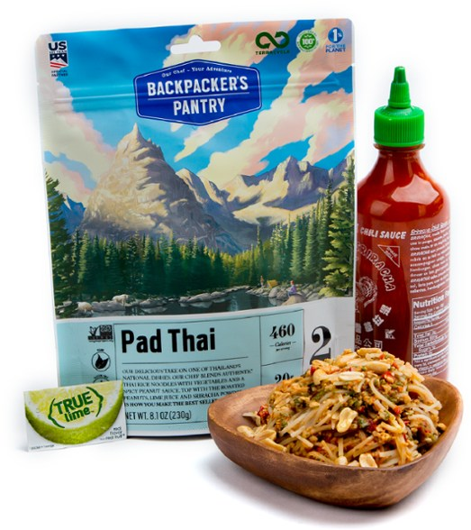
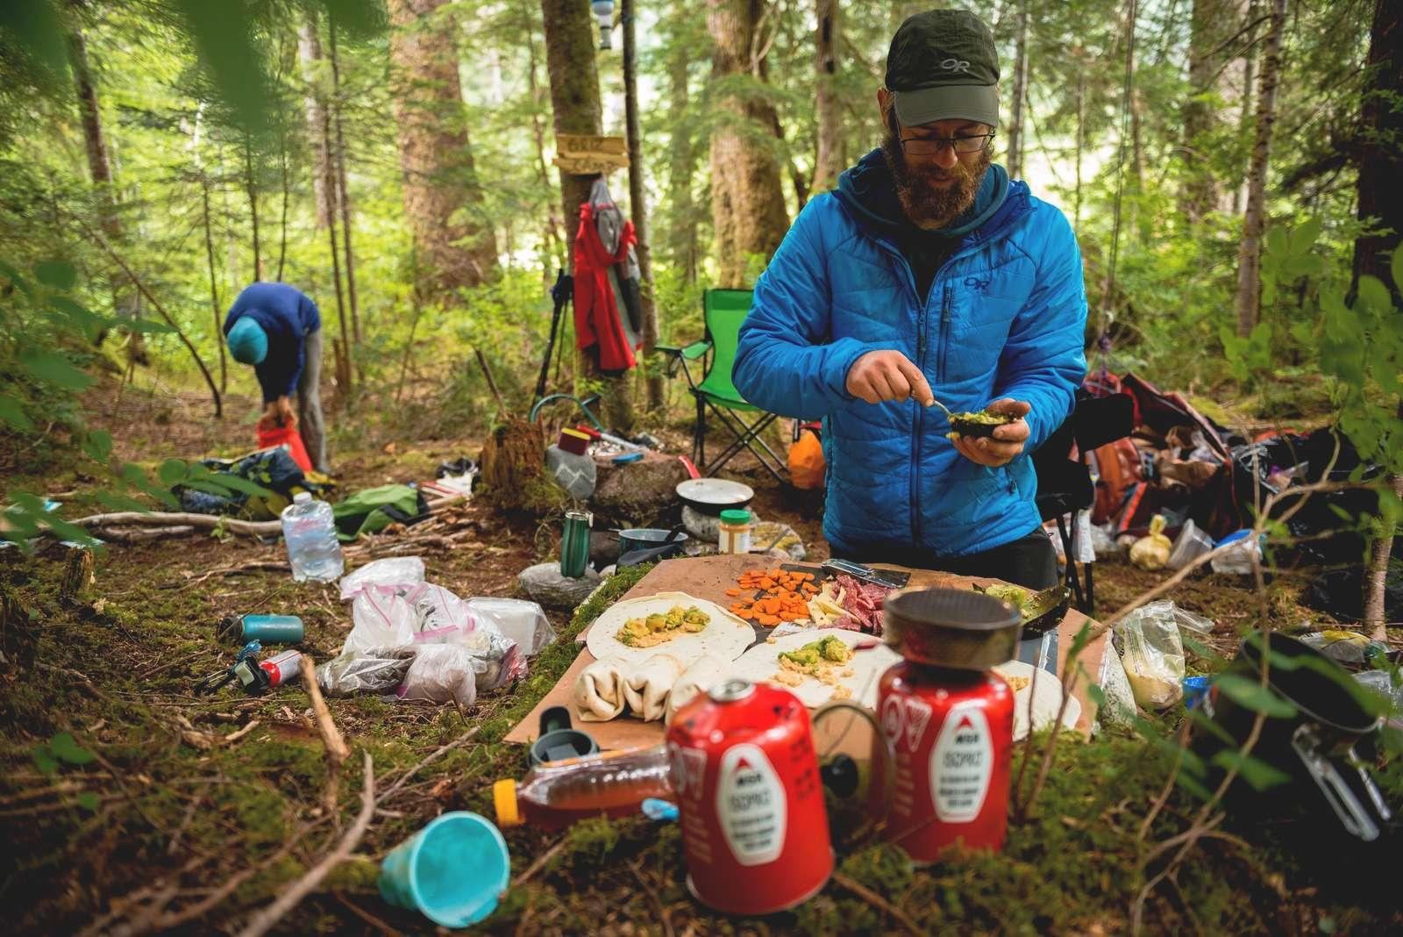
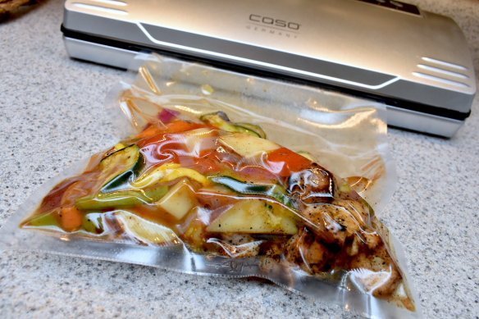
Dehydrated Meals
Prepared Meals
Vacuum Sealed Prepared Meals
(my favorite)
You Cook Meals

Slide 13
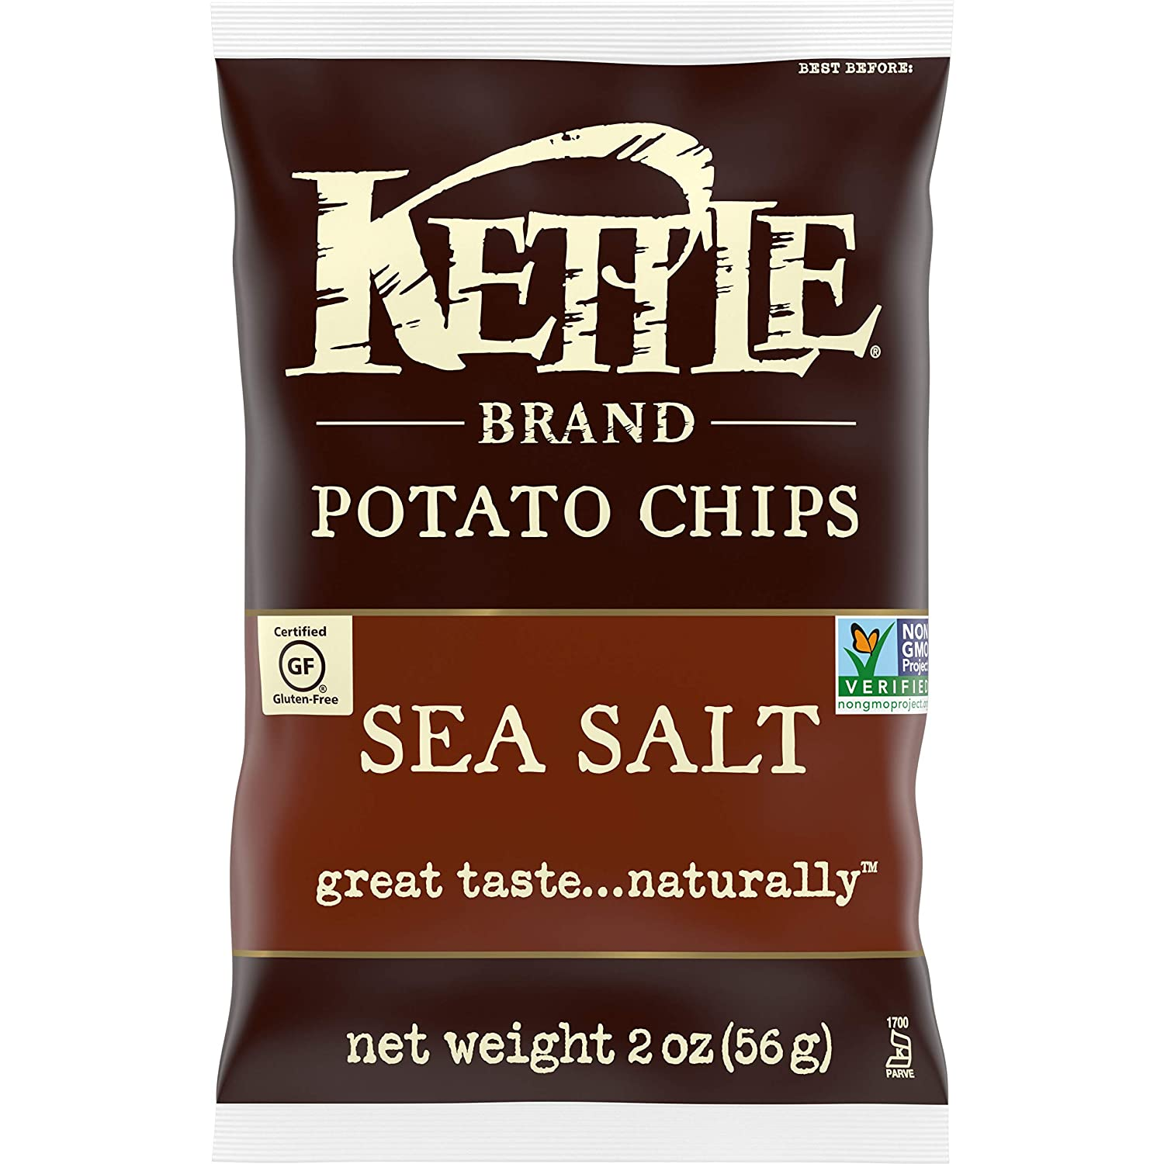
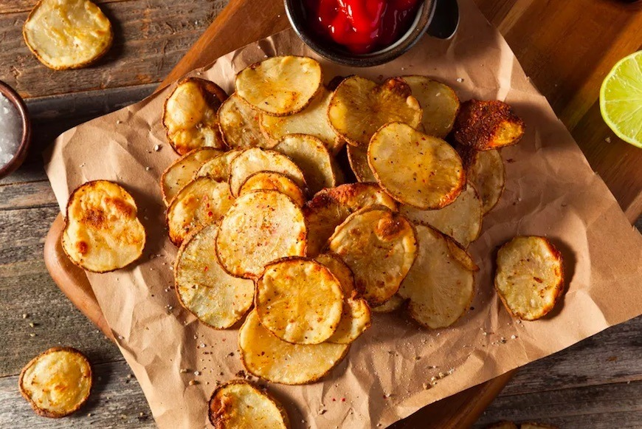
It’s tempting to prepare all super healthy meals, but don’t forget...
...something salty to help replace salts lost through sweat.
Pre-prepared or homemade...it’s up to you!

Slide 14
My favorite source for meal ideas?
freshoffthegrid.com
Break out room! Discuss your favorite meal/prep.

Slide 15
Kitchen Cooking and Clean-Up

Slide 16
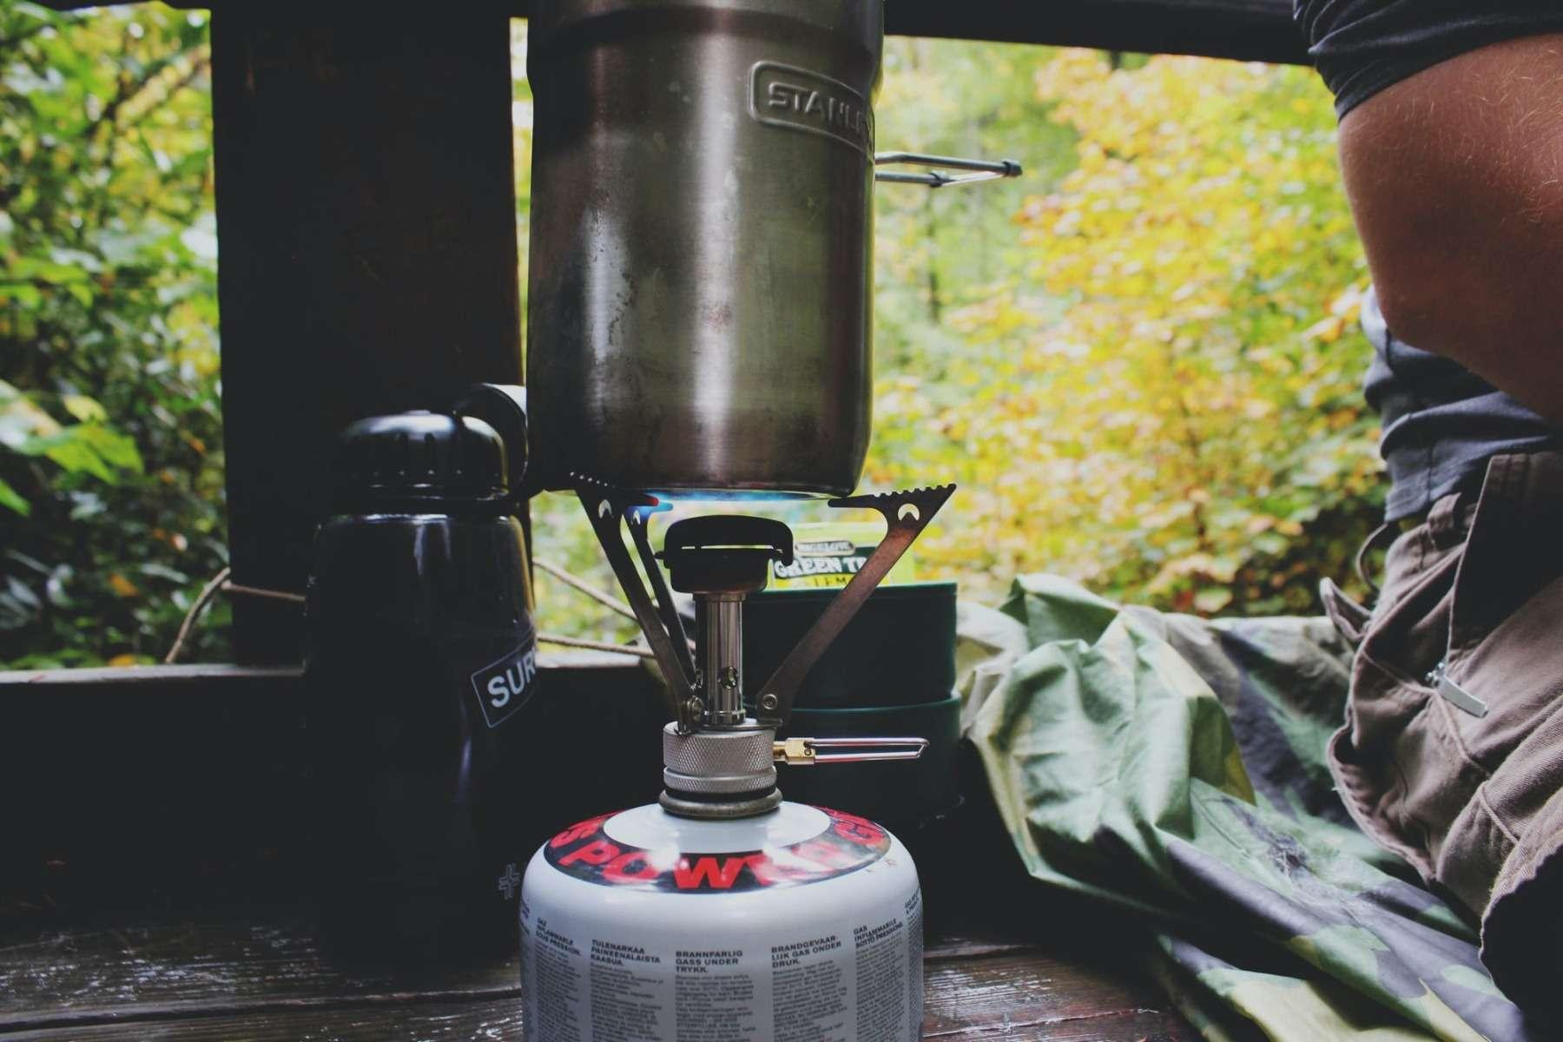
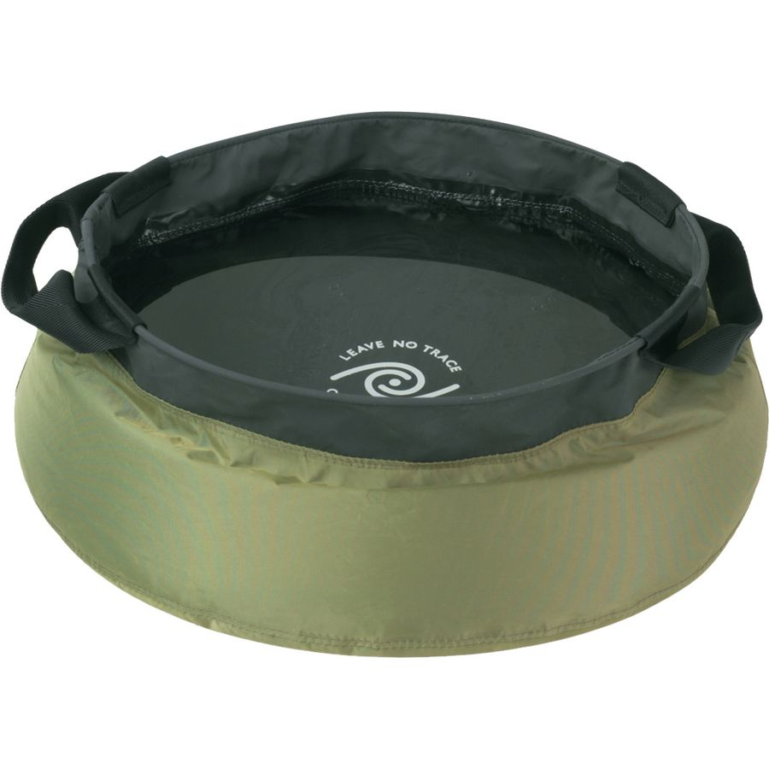
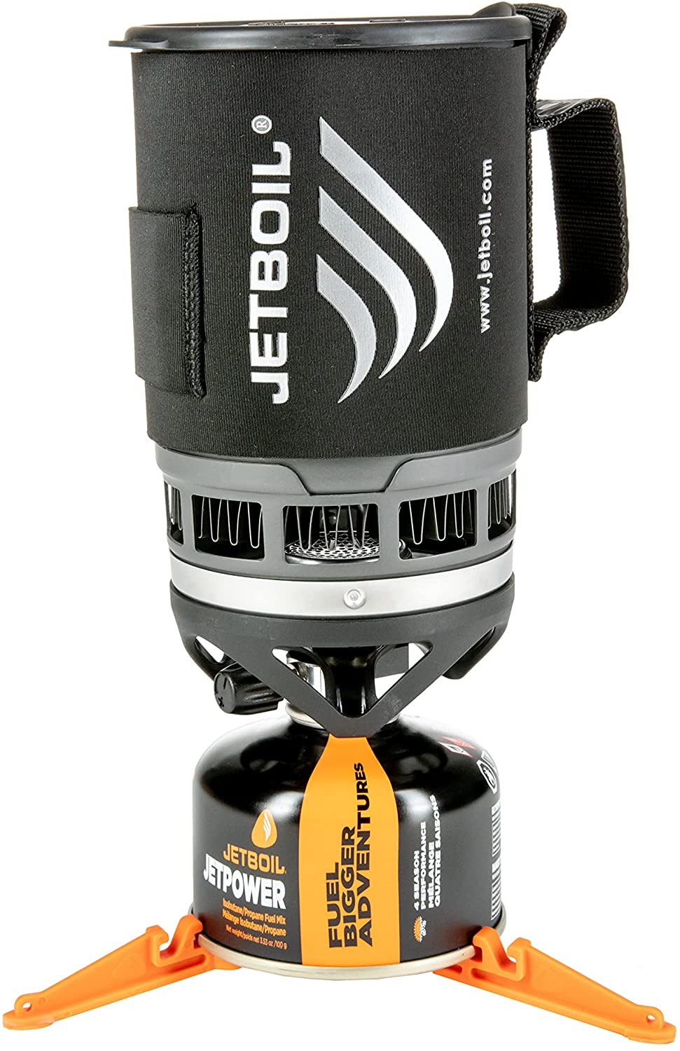
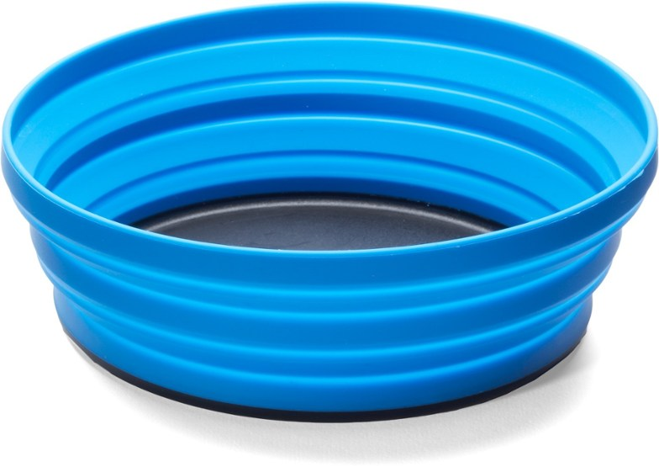
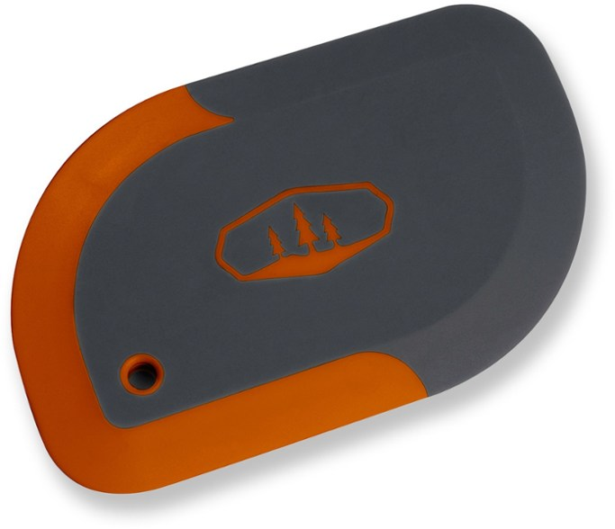
Lots of brand options - think backpacking gear.
Washing Up
Cooking

Slide 17
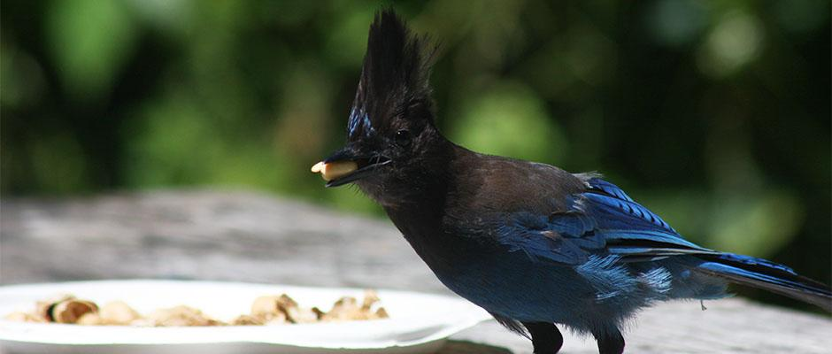
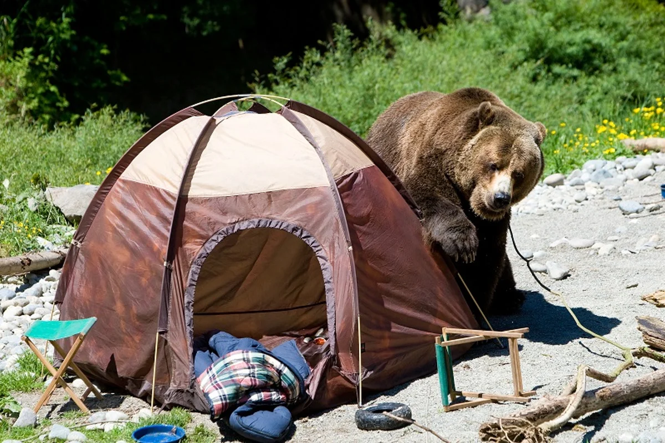
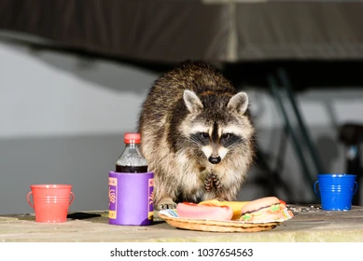
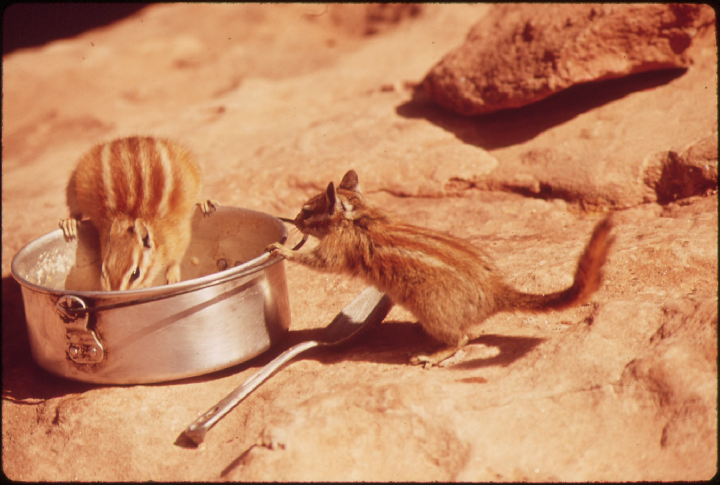
Don’t dump food waste at campsite!

Slide 18
Health and Safety
First Aid
Heat and Cold
Communication
Float Plan
Capsize
Equipment Repair

Slide 19
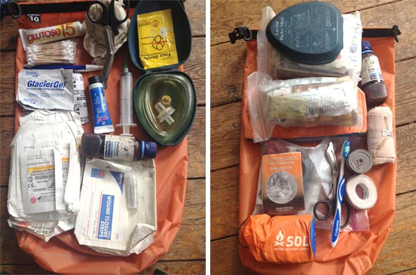
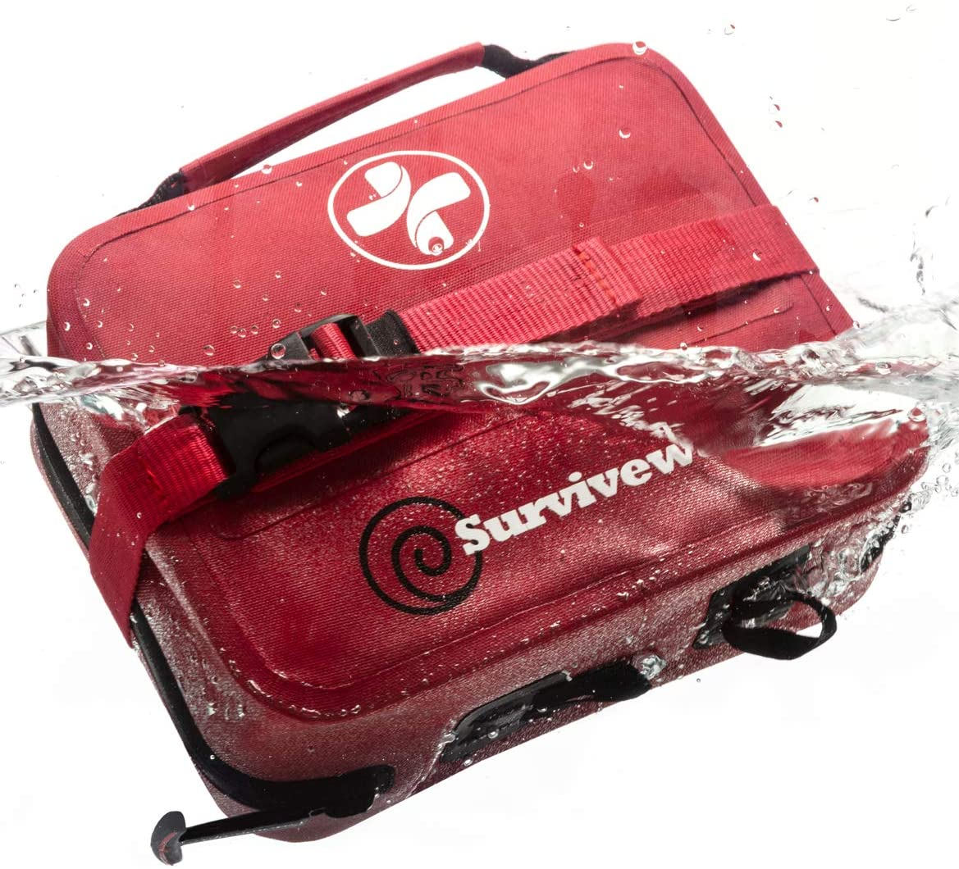
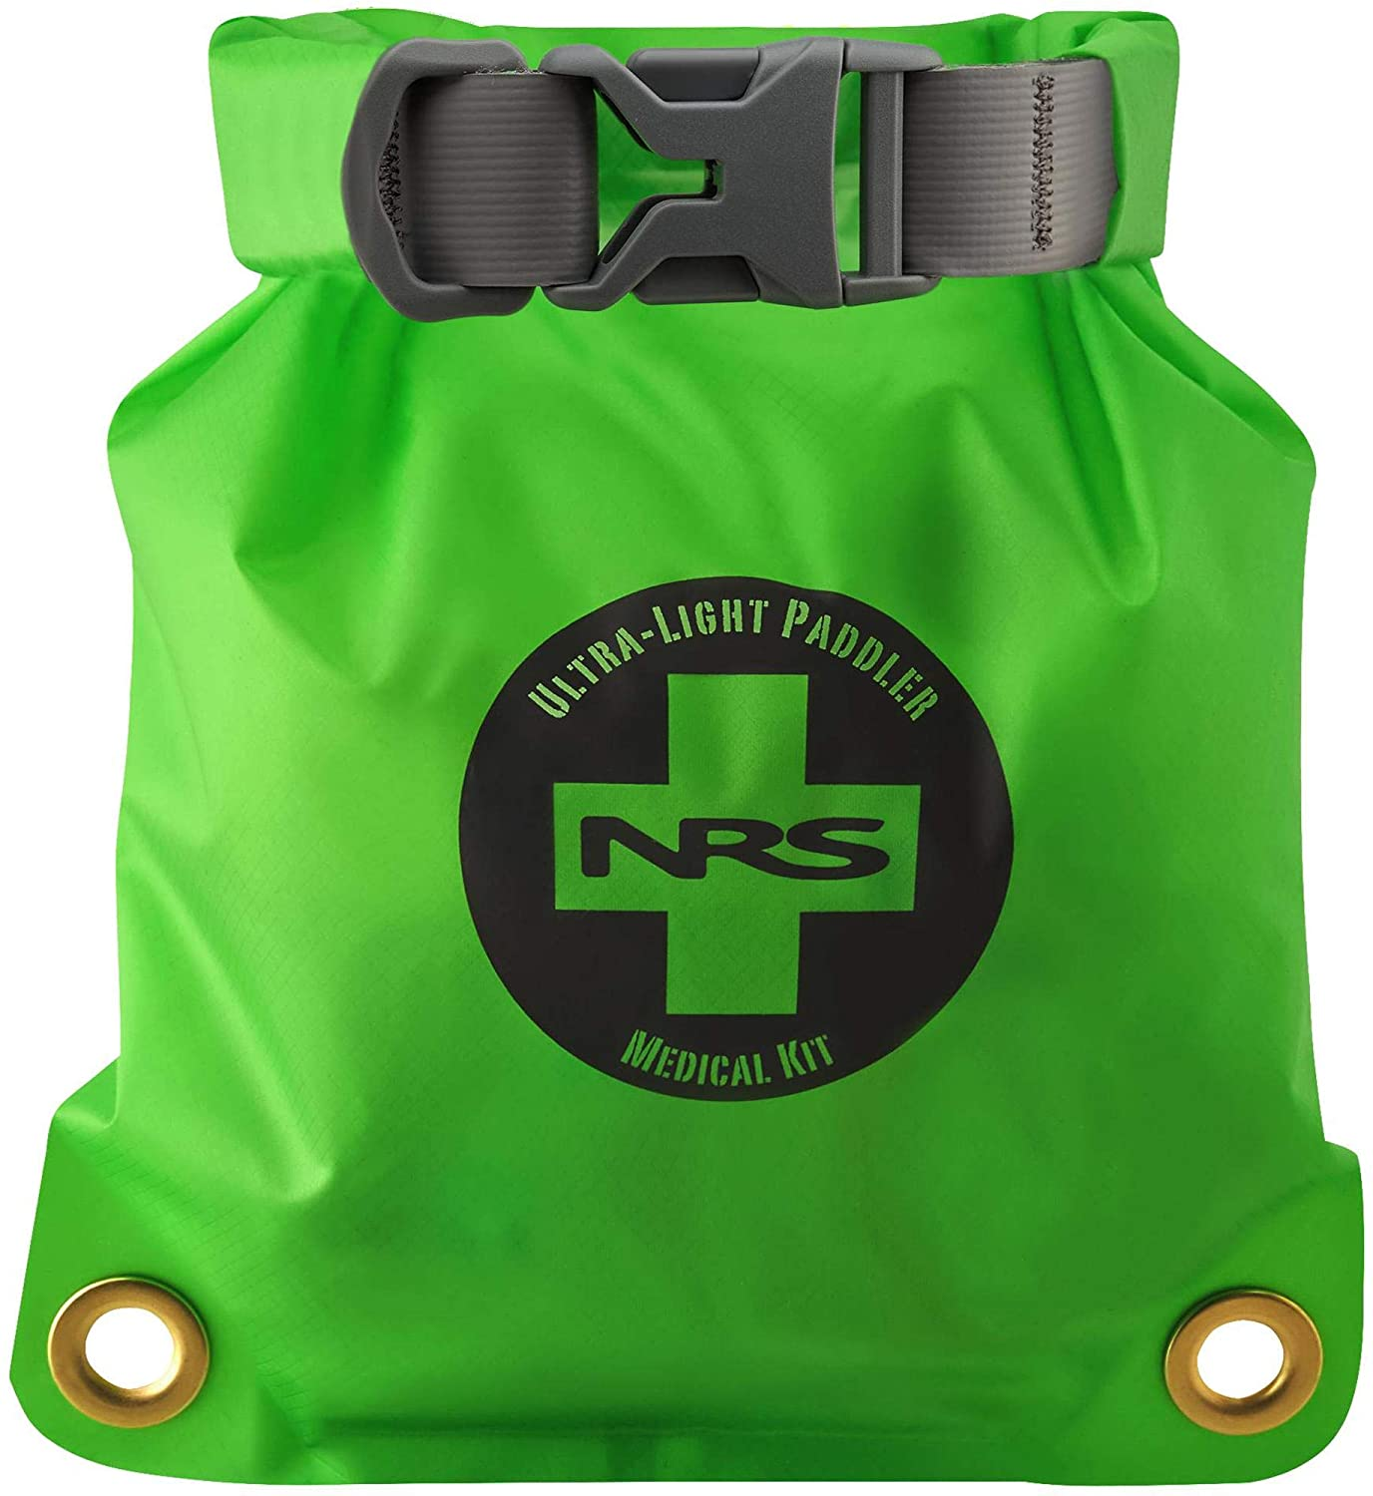
First Aid
First Aid/CPR training is recommended for EVERYONE, not just paddlers.
There are tons of resources available (Google it!), but the American Red Cross is always a go-to.
Wilderness First Aid is another very good skill for kayak campers.
NOLS
Wilderness Medical Associates
What should you put in your first aid kit?

Slide 20
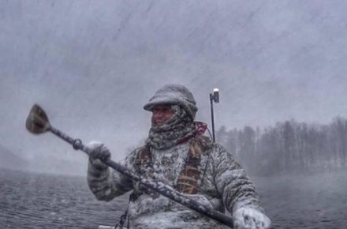
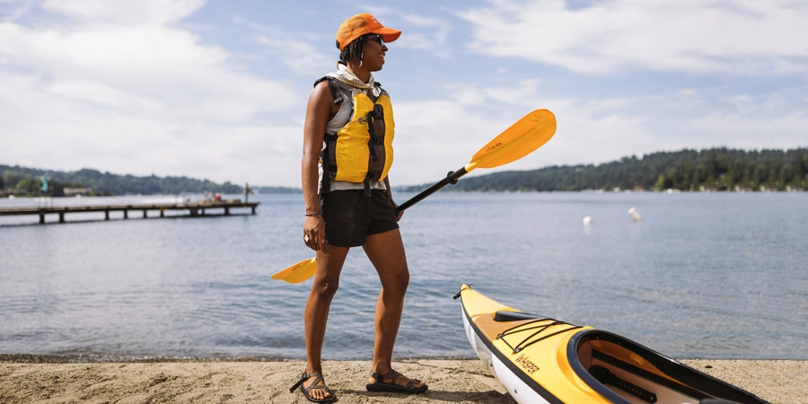
Heat and Cold...what clothes to pack?
Paddling Attire - where you going will dictate whether to bring immersion wear or shorts. Check the weather. Do you need a splash top or drytop?
Tip: Down gear packs small and is warm for cold nights.

Slide 21
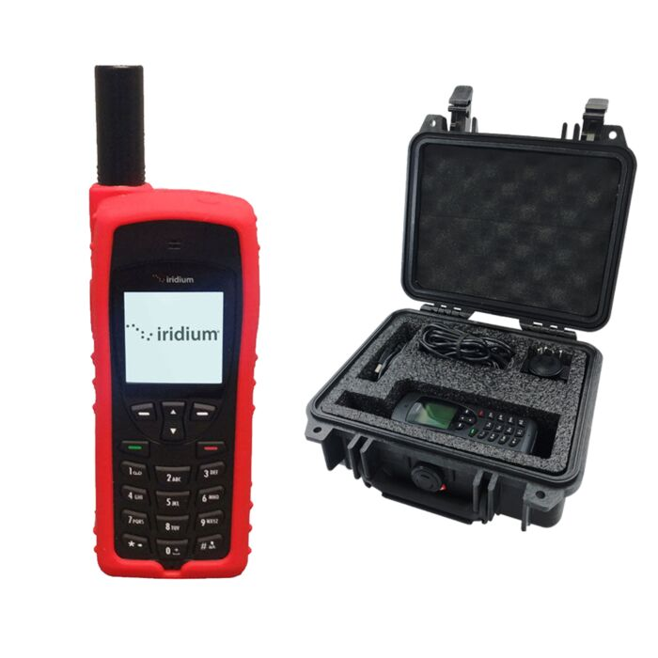
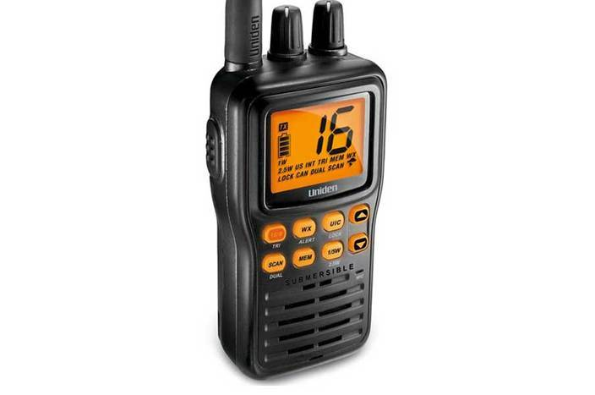
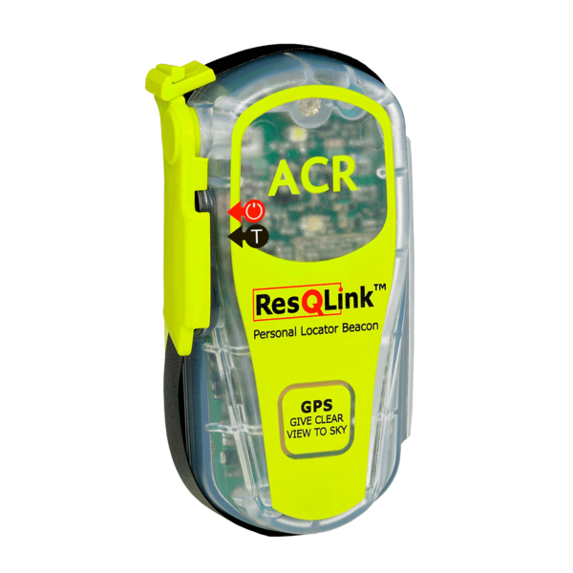
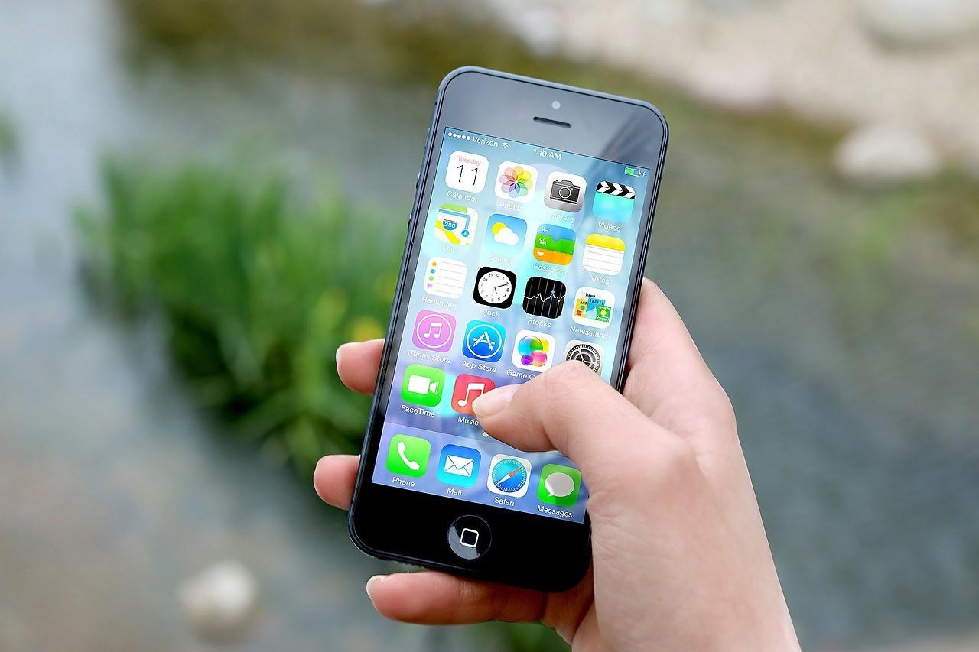
Communication
The Basics of Marine Radio Use

Slide 22
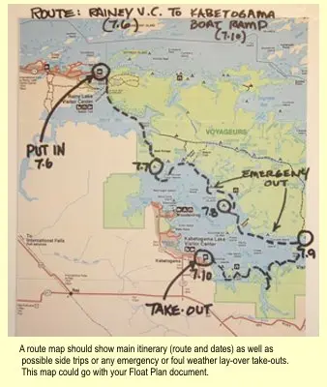
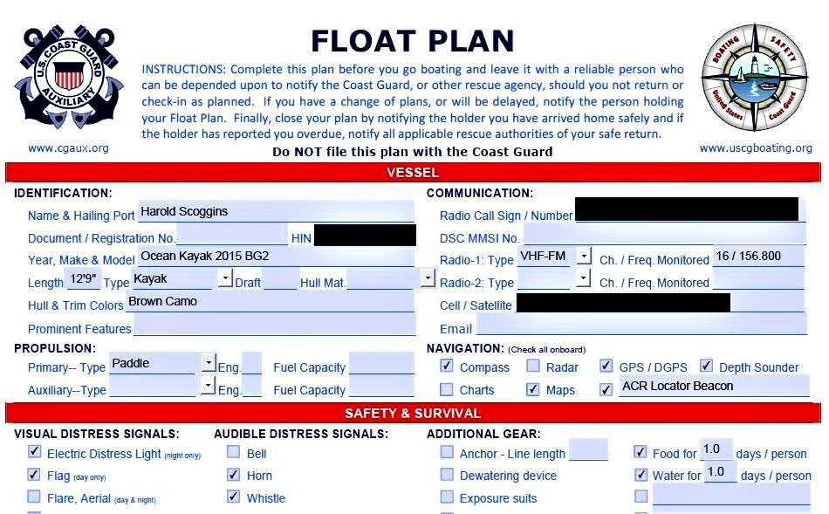
Float Plan
Essential component of any trip!
Very good article from paddling.com “The Float Plan: A Vital Paddling Tool”

Slide 23
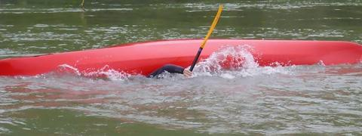
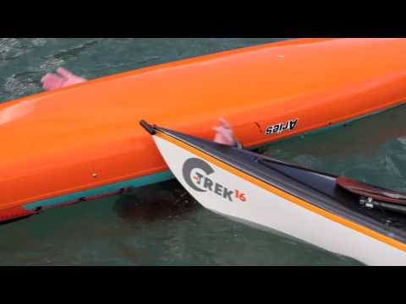
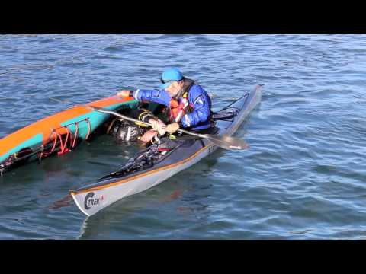
Capsize!

Slide 24
Trip Planning
Where to go
Resources
Leadership
Plan B … and C and D…

Slide 25
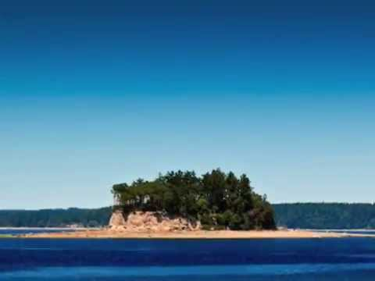
Where to go?
There are so many places in the Pacific Northwest that are wonderful for kayak camping.
Willamette River Water Trail - great for local camping to practice for longer/more difficult places.
Lower Columbia River Water Trail - beautiful, local, more difficult kayaking camping
Cascadia Marine Trail - stunning locations in the Puget Sound (check out longer video on this site).
Break-out Rooms - share your favorite place

Slide 26
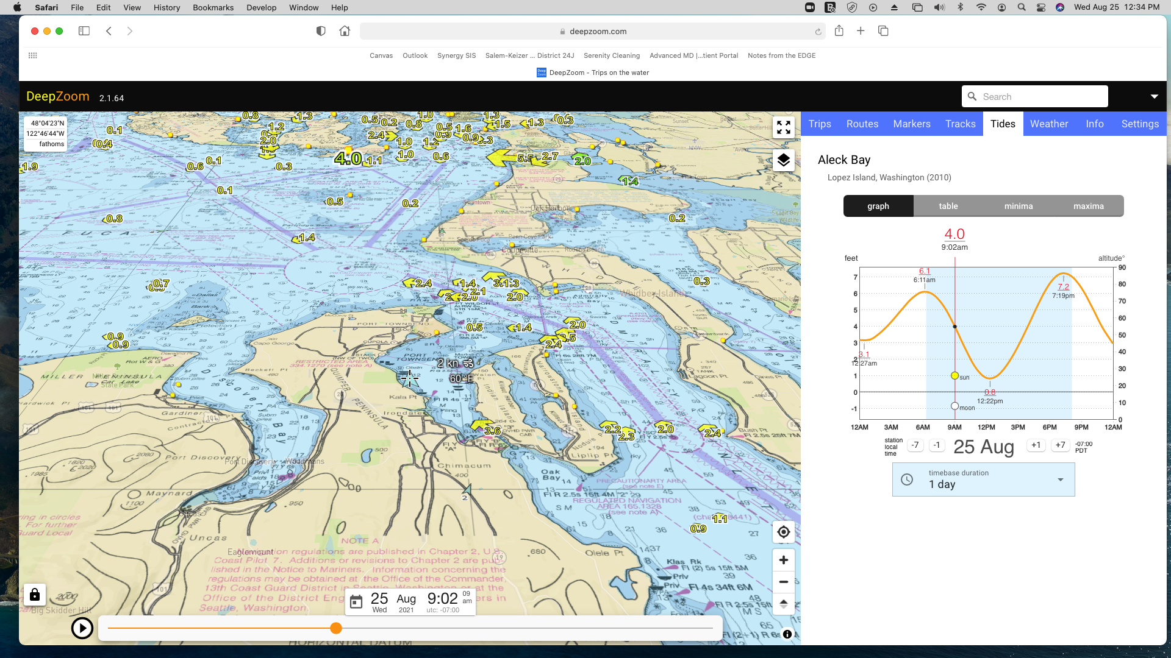
Resources
Charts
Weather
Tides (NOAA) (DeepZoom)
Wind

Slide 27
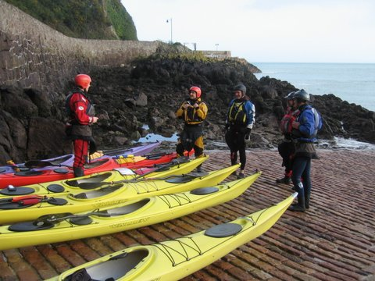
Leadership
“Leadership is not about being out front of the group or being the centre of attention. Leadership is about assisting a group in achieving its goals.”
A really good article on kayaking leadership from East Coast Kayaking, Australia
Preparation
Communication
Expectations

Slide 28
Paddle Canada

Slide 29
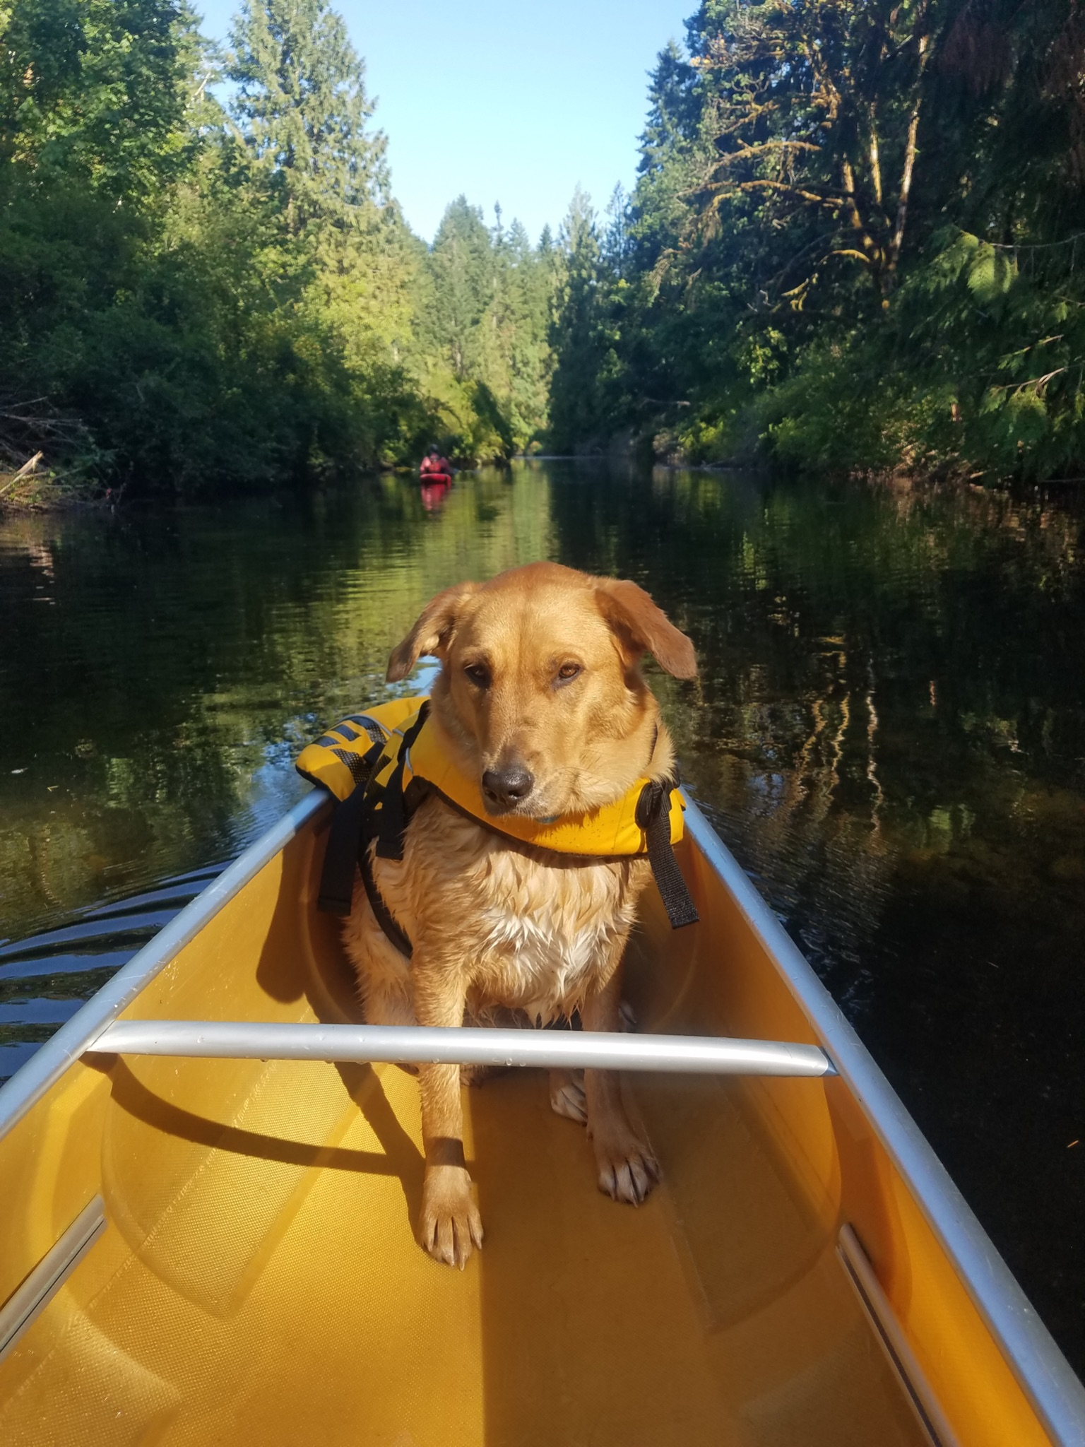
Questions? Comments?
Ask aloud or put in the chat!

